Slide 1
Introduction to UML
Structural Diagrams

Slide 2
Introduction
Structural Diagrams
Class Diagram
Component Diagram
Package Diagram
Deployment Diagram

Slide 3



Structural Diagrams

Slide 4
Structural Diagrams
Project Vocabulary
Structural Relationships
Architectural Diagrams

Slide 5
Class Diagram
Vocabulary
Relationships
BillPayer
SchedulePayment() ImmediatePayment()
<<Future>>
Allow Multiple Accounts for a Payment
Payee
Customer
*
*
Account
*
1
Account Holder
“Boxes and Lines”
1
*
Address
CheckingAccount
SavingAccount
minimumBalance
interestRate

Slide 6







Common Users of Class Diagrams
Product Owner
Business Analyst
Architec t
Operations
Quality Assurance
Developer

Slide 7


Classes and Interfaces
Class
Represents an Entity (Noun)
Attributes
Operations
Omit Details if not required
Interface
 | Account
 | balance Deposit() Withdrawl()
Customer
<<Interface>>
IAccount
Deposit() Withdrawl()

Slide 8
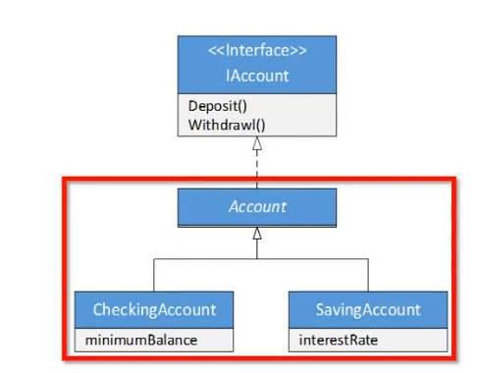
Implementation and Inheritance
Implement Interface
Inheritance (“Is A”)
Abstract Class
Concrete Class

Slide 9




Relationships
Basic (“Has A”)
Multiplicity
Aggregation
Whole - Part
Composition
Ownership
Uses
Customer |  |  |  | Account
 |  | * *
Payee
Customer
*
1
1
*
Address
BillPayer
SchedulePayment() ImmediatePayment()
Payee
Account

Slide 10
Basic Class Diagram
BillPayer
<<Future>>
SchedulePayment()
ImmediatePayment()
Allow Multiple Accounts for a Payment
Payee
Customer
*
*
Account
*
1
Account Holder
1
*
Address
CheckingAccount
SavingAccount
minimumBalance
interestRate

Slide 11


Component Diagram
Identify Interfaces
Define replaceable parts
Online Bill Payment
Configuration
Payments
Payment Processor
Logging
Logger
Instrumentation

Slide 12

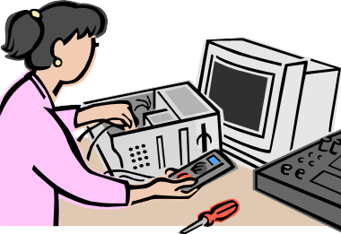
Common Users of Component Diagrams
Business Analyst
Product Owner
Architec t
Operations
Quality Assurance
Developer

Slide 13


Basic Component
Component
Interfaces
Realized
Required
Online Bill Payer
Payment
Payee
Online Bill Payer
Account

Slide 14


Connected Components
Loosely Connected
Tightly Connected
Instrumentation
Payment
Payee
Investment Service
Online Bill Payer
Account

Slide 15


Basic Component Diagram
Online Bill Payment
Configuration
Payments
Payment Processor
Logging
Logger
Instrumentation

Slide 16
Package Diagram
Logical Container
Support Large Models
WebClient
Logging
OnlineBillPayer
ChildSavingsPlan
BirthdayBonus
InvestmentServices

Slide 17
Common Users of Package Diagrams
Business Analyst
Product Owner
Architec t
Operations
Quality Assurance
Developer

Slide 18
Simple Packages
Basic
Showing (relevant) elements
Can Contain
Classes
Interfaces
Components
Nodes
Diagrams
Packages
Etc.
AccountServices
OnlineBillPayer
ChildSavingsPlan
InvestmentServices

Slide 19

Nested Packages
Contained Packages
Maximum 2 or 3 deep
Packages define scope
Qualified Names
Use double colon - ::
RateCalculator
IncomeVerification
AccountServices::LoanProcessing::RateCalculator

Slide 20
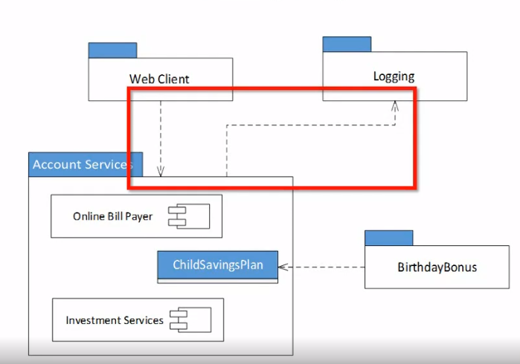
Basic Package Diagram

Slide 21
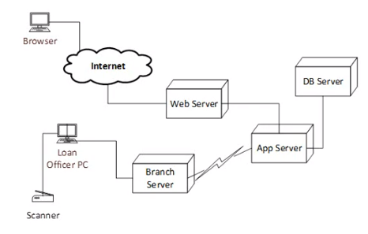
Deployment Diagram
Map Components to Physical Systems
View Special Devices
Visualize Hardware and Network Dependencies

Slide 22


Common Users of Deployment Diagrams
Product Owner
Architec t
Business Analyst
Operations
Quality Assurance
Developer

Slide 23

Nodes
Processors
Cubes
Stereotyped
Detailed
Devices
Networks
Specialty
<<processor>> Database Server
<<processor>> 2-* Application Server
Web Server
Deploys: AccountServices Logging
Internet
Scanner

Slide 24




Basic Deployment Diagram
Browser
Internet
DB Server
Web Server
App Server
Loan Officer PC
Branch Server
Scanner

Slide 25
Overview of PlantUML
What is PlantUML?
PlantUML is an open-source tool that allows users to create UML
(Unified Modeling Language) diagrams from plain text descriptions.
It supports various UML diagrams like class diagrams, use case diagrams,
sequence diagrams, and more.
Key Features
Uses a simple, human-readable text language to describe the diagrams.
Diagrams are rendered as images in formats like PNG, SVG, and ASCII art.

Slide 26
Summary
Structural Modeling
“Parts” of the system
Model what is relevant
Class Diagrams
Vocabulary
Component Diagrams
“Pluggable” sub-systems
Package Diagrams
Support large system models
Deployment Diagrams
Physical dependencies

